Slide 1
A Haunted Halloween
By Mrs. Bushman

Slide 2
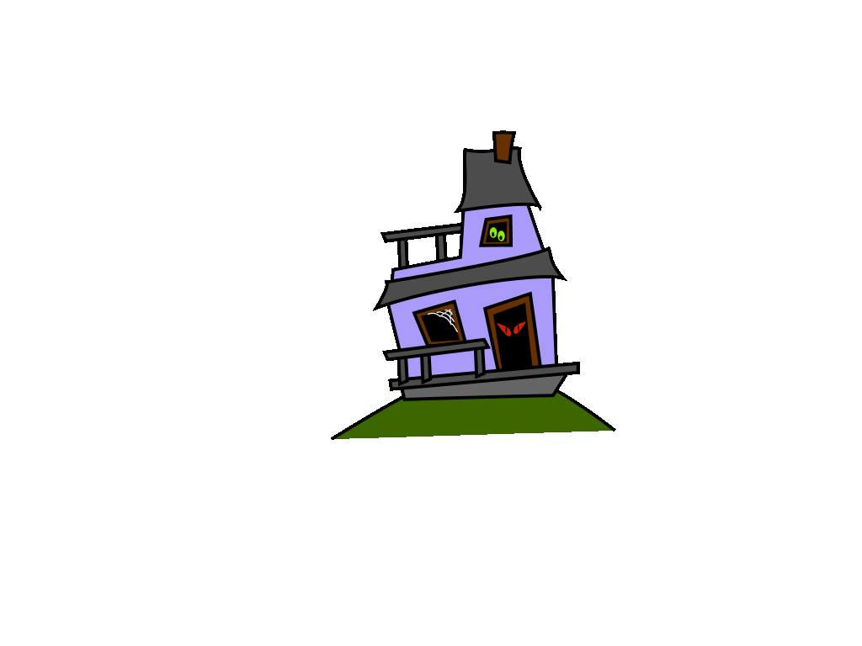
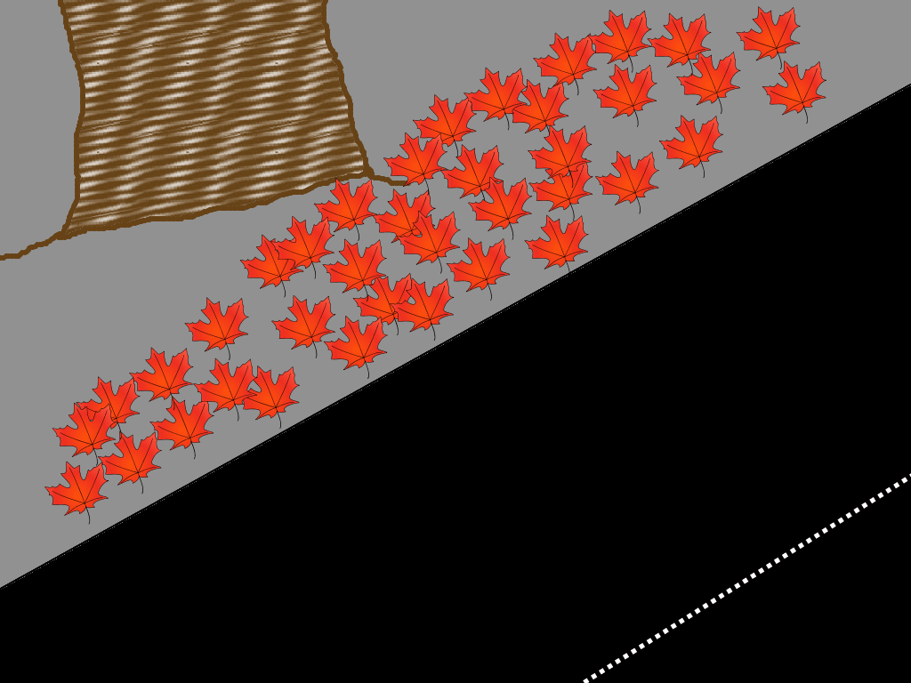
Sarah and Beth walked down Haunted Lane. They had just finished trick or treating and were on their way home.
Haunted
Lane
Did they:
Stop at the Haunted House?
Continue to walk down Haunted Lane?

Slide 3
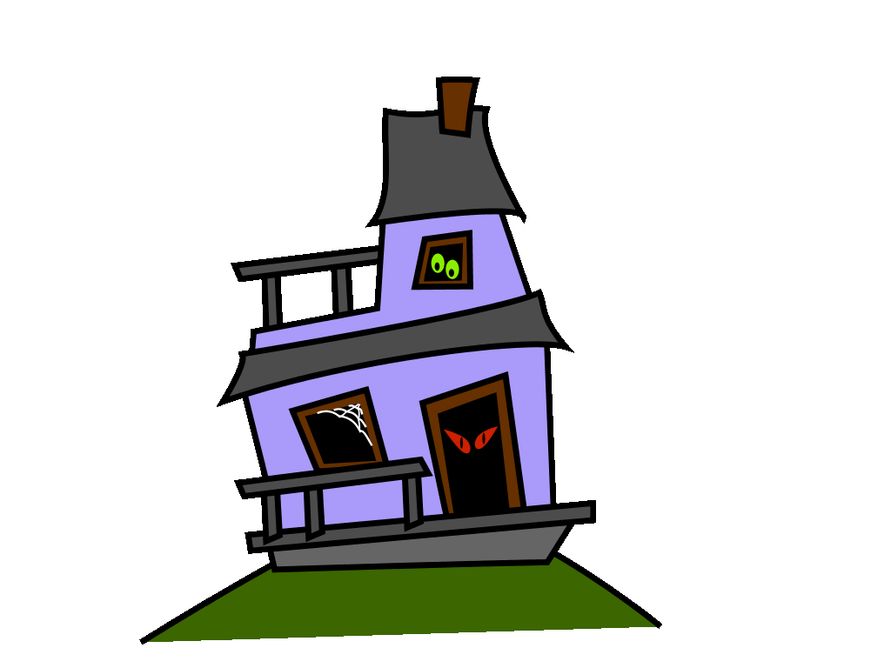


They stopped at the Haunted House. It was very spooky looking, but they had always wanted to see inside. They slowly crept their way onto the front porch to the front door.
What happened next?
Adventure #1
Adventure #2

Slide 4
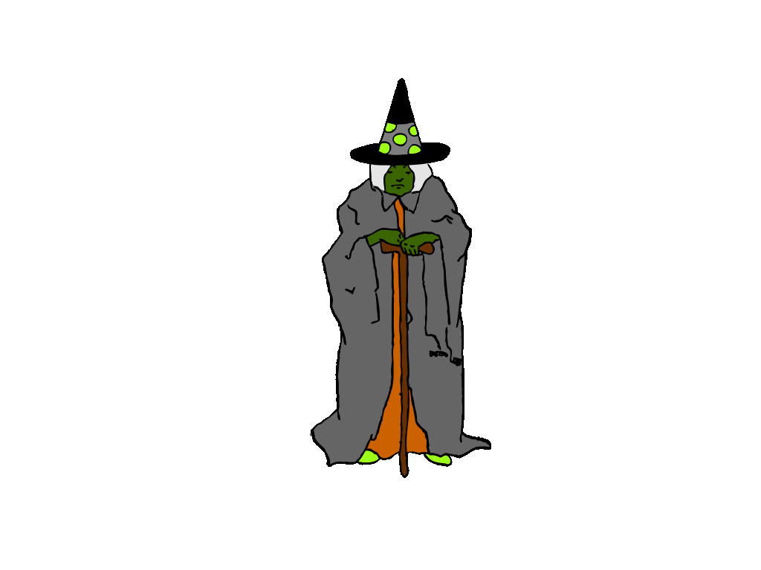

They continued down the Haunted Lane to see what else was there.
Adventure #1
Adventure #2

Slide 5



They stood in shock! That door opened by itself!
What did they do?
They went inside the house.
Surprise!

Slide 6
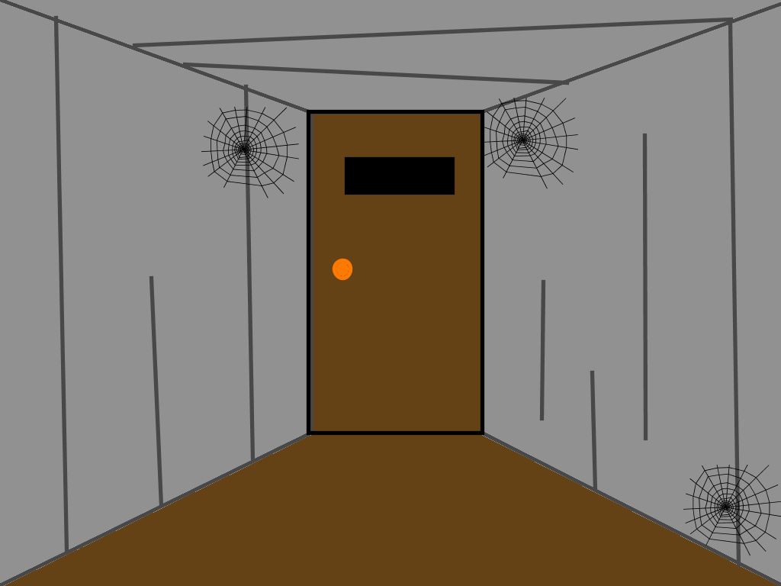
They went up on the front porch and opened the door.
What happened next?
They went inside the house.
Surprise!

Slide 7
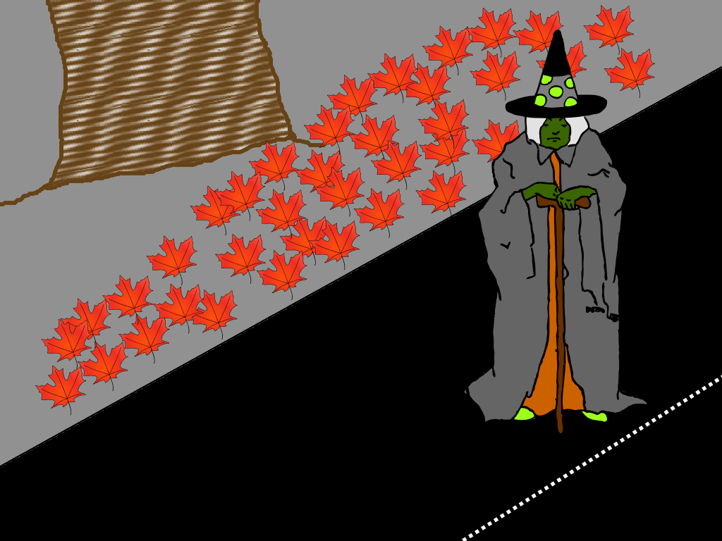

They came across an old witch with a crooked nose.
Hear the witch cackle!
What do you think happened next?

Slide 8
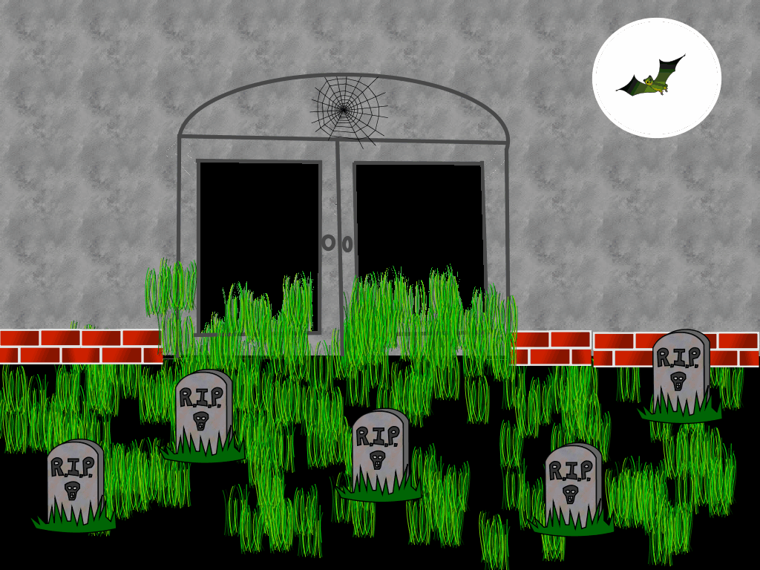
They found an old cemetery.
Do you dare to go in?
What other surprise could happen?

Slide 9
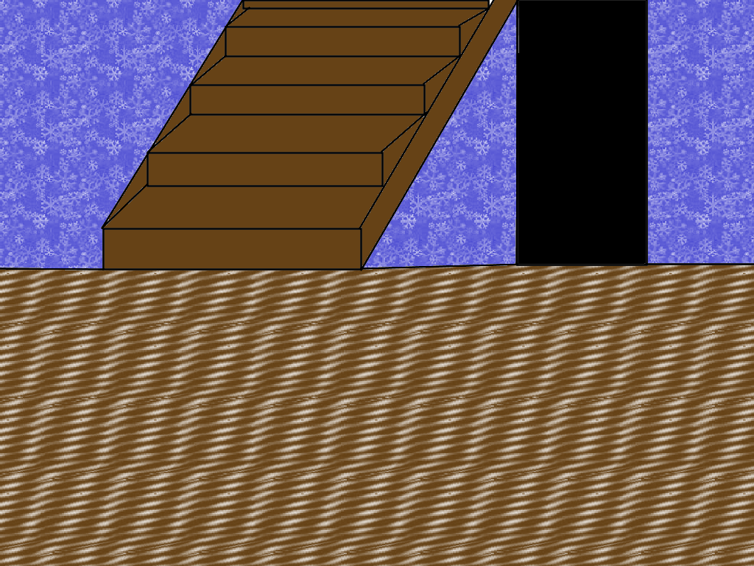

They went inside the house.
What did they see?
Click Here

Slide 10
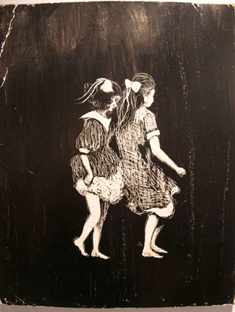
They ran away and went home!
What, you want more?

Slide 11

A black cat ran past them out of the house!
Click Here

Slide 12
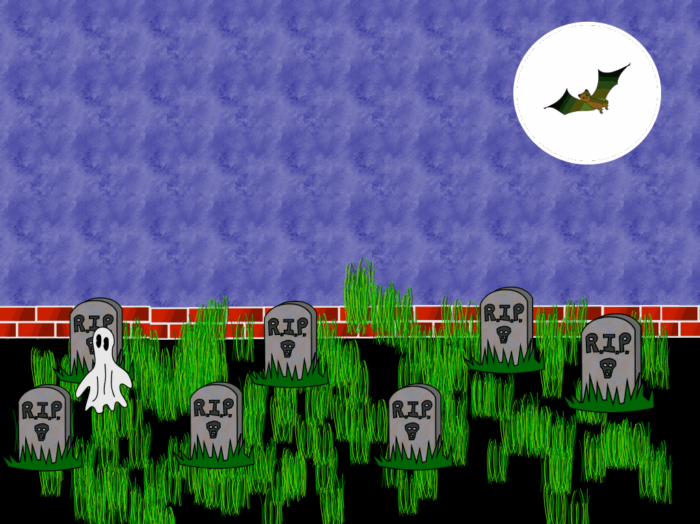
They opened the gate and walked into the cemetery.
Click Here

Slide 13

An owl swooped down past them from a nearby tree!
“He’s coming after us,” said Beth. “Let’s get out of here!”
Click Here

Slide 14
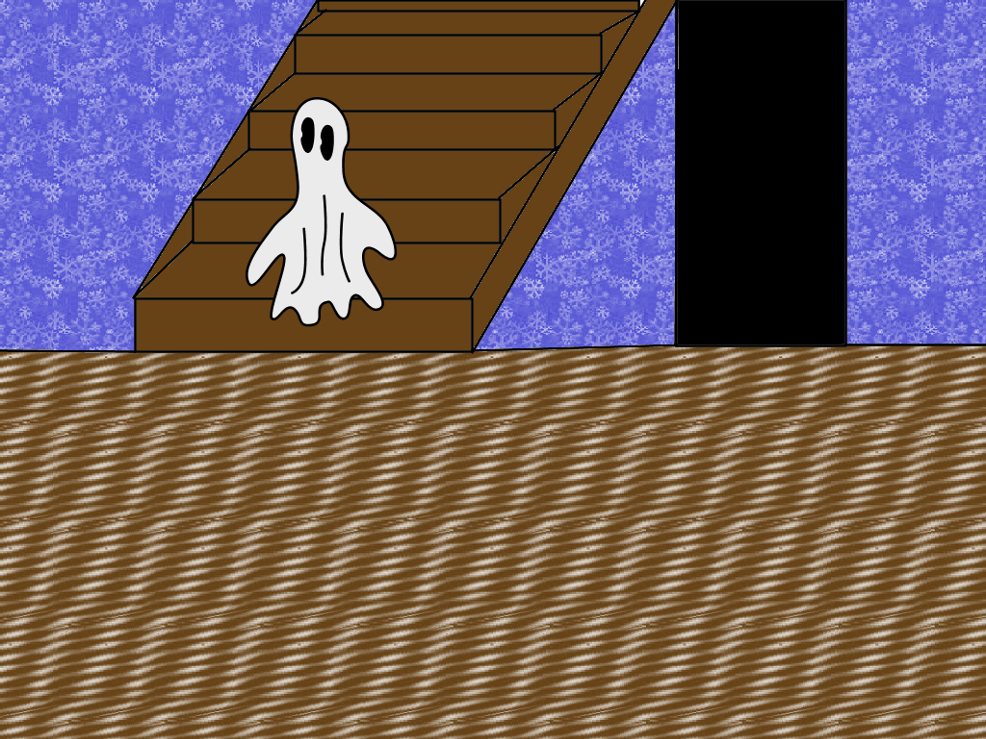
They saw a ghost at the foot of the stairs! “Oh, no!” Sarah yelled, “let’s get out of here!”
Click Here

